Slide 1

Online Banking System
Sec01-Group08
Bank of computer science

Slide 2
Gantt chart discussion
Notes:
The change in the timeline impacted the Gantt chart. For example, due to the change in the time allowed to do the implementation, implementing classes and UI had to be split up and done at the same time instead of being done one after the other. A lot of the tasks were reorganized among the group members depending on everyone’s strengths and interests.

Slide 3
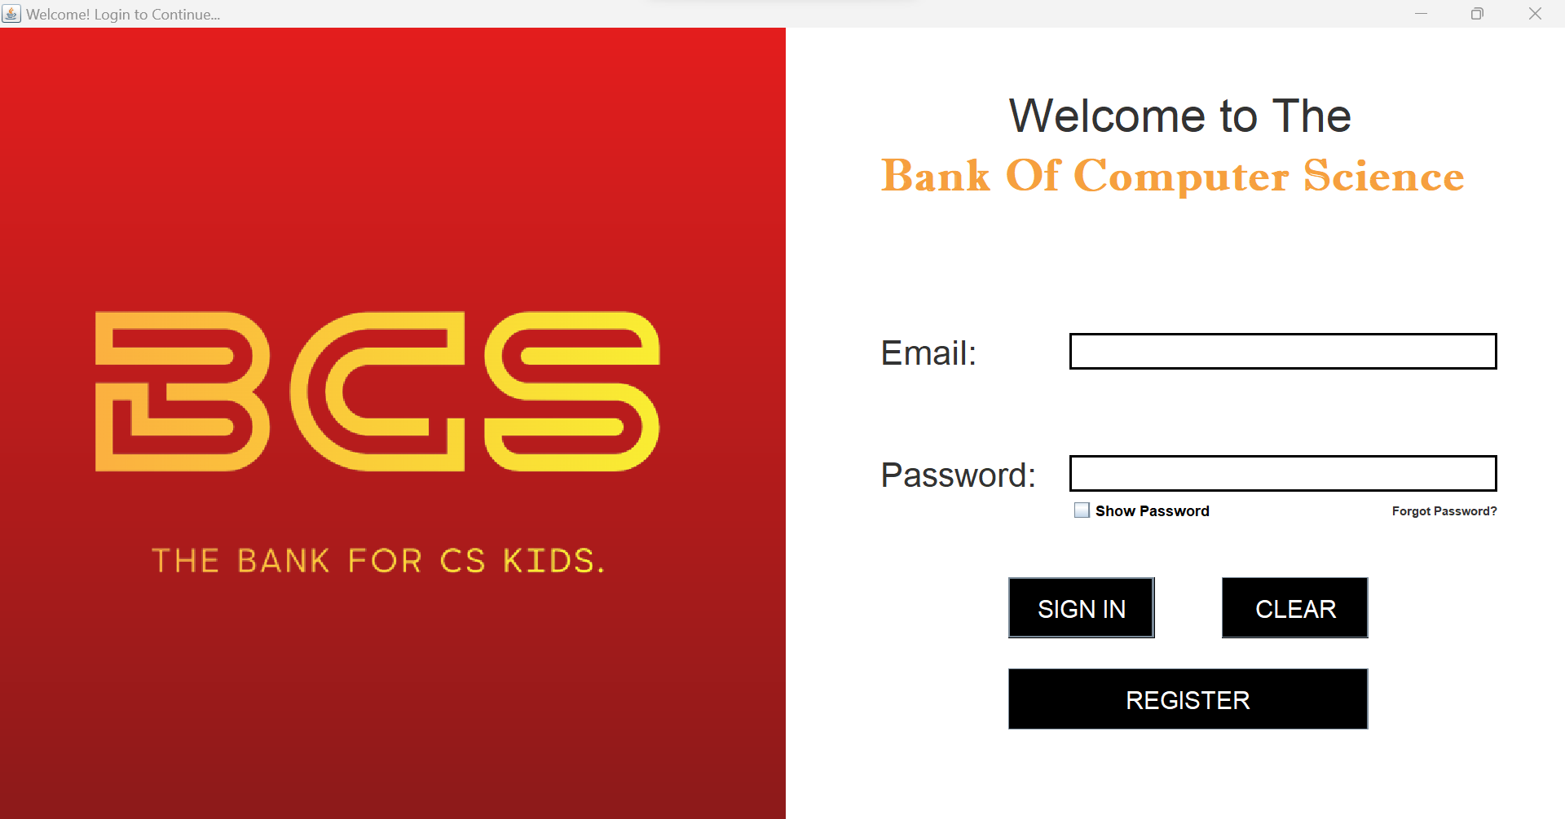
System Domain & Objectives
Our system is within the domain of online banking.
Our objectives are to provide customers (specifically CS students) with an easy way to access their bank accounts with us online.
Unique identifiers are provided for our customers to ensure security.
Notes:
Objectives: Login to your account, Register an account, Transfers, Manage settings, Find a nearby location
System Domain: Design a online banking system that simulates all the objectives in an easy, accessible way.

Slide 4
Requirement Analysis
Notes:
Talk about assumptions, STDs, FR and NFR

Slide 5
Use Cases & Use Case Diagram
Notes:
Use Cases: Make and Receive Payments (e-transfers and bank transfers), locate a nearby branch, view transaction history and balance, manage settings, request assistance from one of the other actors (MT/CSR/AD), Request a Meeting from admin.

Slide 6
Design Phase
We created 18 Sequence and 18 Activity diagrams, one for each use case
They clearly define (as complements of each other) how the system works to fulfill each use case
A class diagram including all the classes involved in the system was also designed
The tasks were split to account for time limits and quality check
Notes:
Class/Sequence and activity diagram discussion

Slide 7
Sequence and Activity Diagrams
Notes:
Class/Sequence and activity diagram discussion

Slide 8
Implementation and testing Phase
Given the changes to the time dedicated for implementation and testing, the task was split up accordingly.
UI implementation and method creation and testing were all done successively, with some overlapping to allow for the time frame.
Notes:
Discussion about various methods and UI classes used

Slide 9
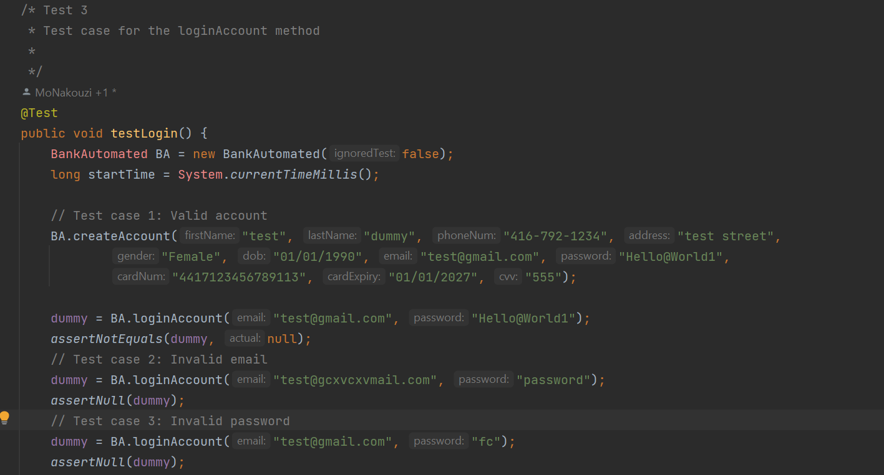
Unit Tests
Notes:
Discussion about several unit tests, how each function was tested, how bug fixes were made to account for any failed unit tests

Slide 10
Risk Management
Risk management and prototype analysis was done at the end of each phase.
Various limitations and extensions were identified, and changes in various prototypes were made to account for various limitations.
Some limitations continue to persist.
Notes:
Discussion about different risks identified, such as no encryption algorithm and how it can be extended in the future

Slide 11
Extensions And Limitations
Extensions | Limitations
Card number checker is implemented, with first digit check and Luhn’s algorithm Password checker to maximize security to ensure password is up to certain standards Various checks are done within the system to ensure correct data is inputted | No access to valid global bank account numbers, any 5-digit number accepted No access to valid emails, any email that passes local checker is accepted No implementation for the admin/other actor systems
Notes:
Provide examples of the various checks done (DOB checker, transfer amount checker, self-transfer checker). Explain the local email checker we have.

Slide 12
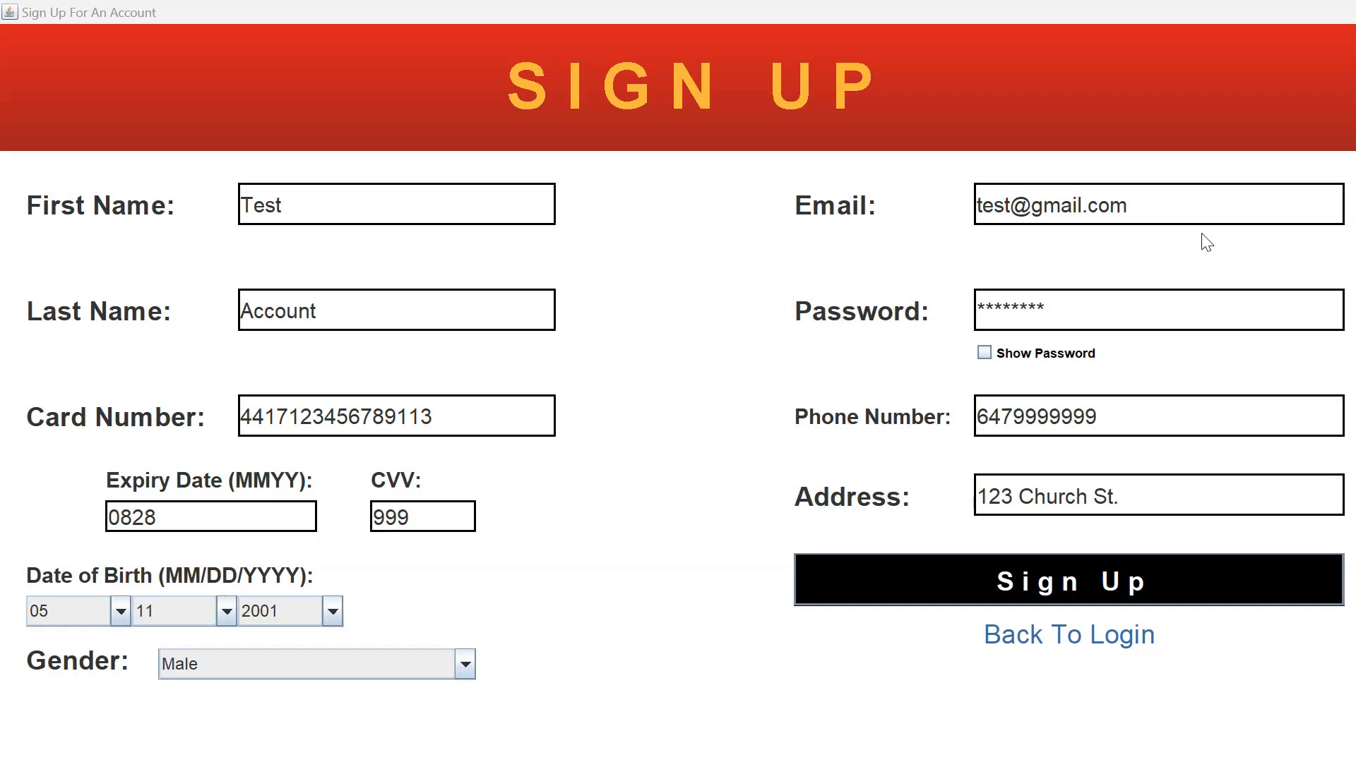
Quick DEMO

Slide 13
Thank you

